Slide 1
Cities in shape:
Assessing the impact of urban form on accessibility
Clara Peiret-García
Prof. Rachel Franklin
Dr. Alistair Ford
Dr. Joe Matthews

Slide 2
Introduction
Research question
Methods
Results
Conclusions

Slide 3
Accessibility & urban form

Slide 4
Accessibility
Accessibility is the ease with which opportunities can be reached from an origin [1]
[1] Páez, A., Scott, D.M. and Morency, C., 2012. Measuring accessibility: positive and normative implementations of various accessibility indicators. Journal of Transport Geography, 25, pp.141-153.

Slide 5
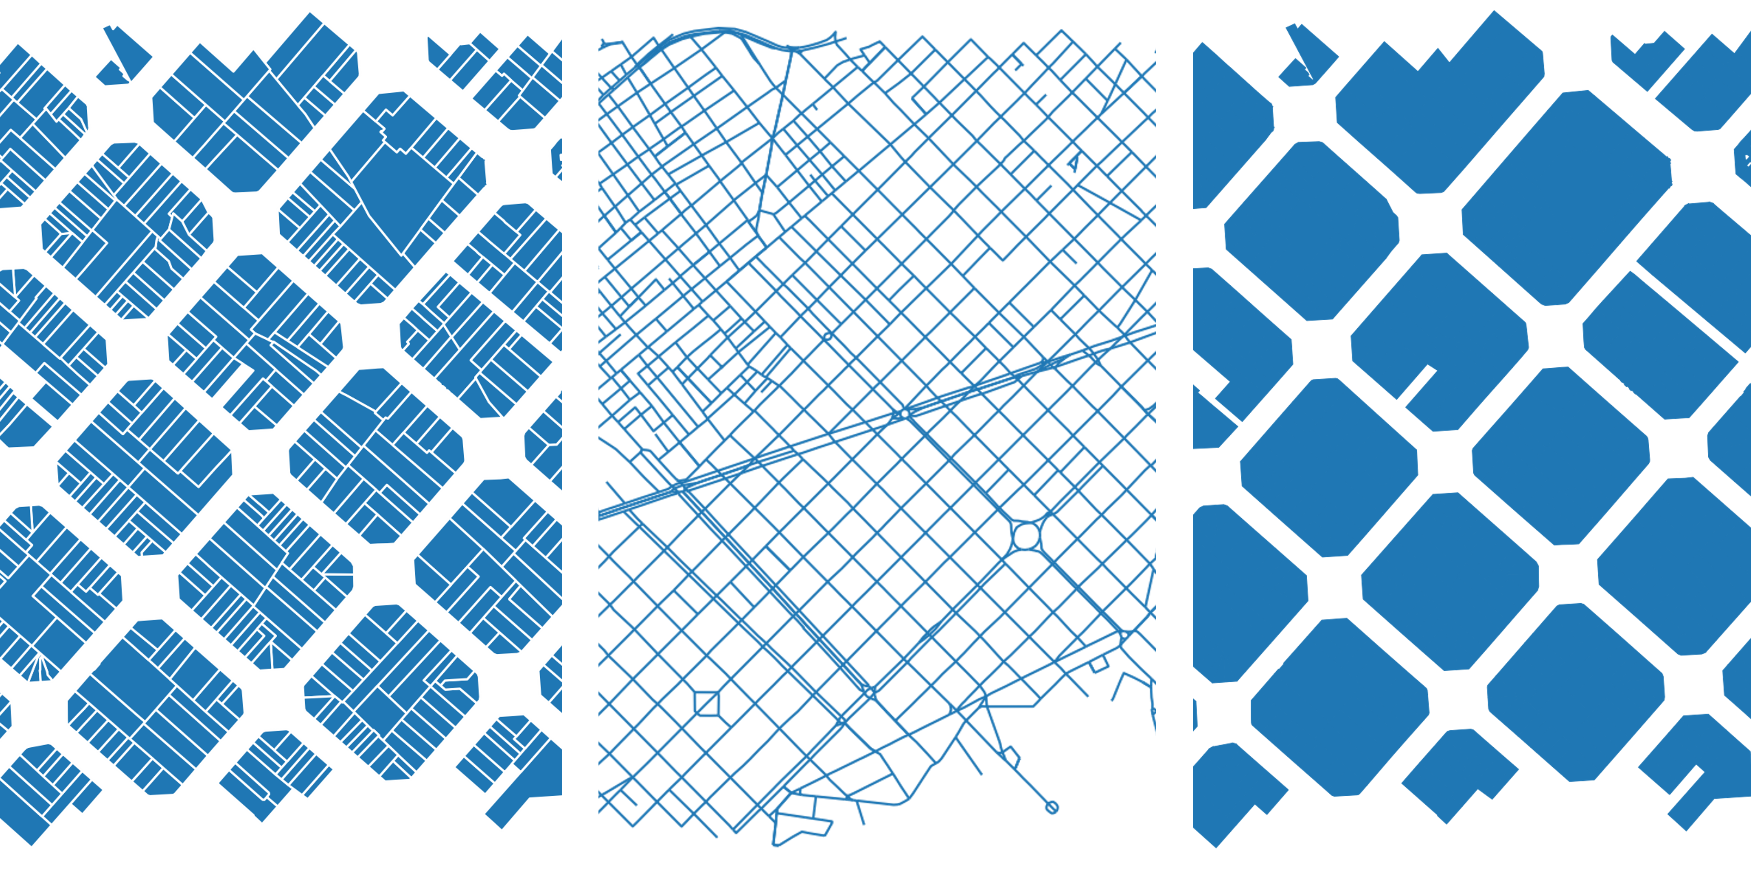
Urban form
[2] Oliveira, V., Oliveira, V. (2016). Urban Morphology: An Introduction to the Study of the Physical Form of Cities. Germany: Springer International Publishing.

Slide 6
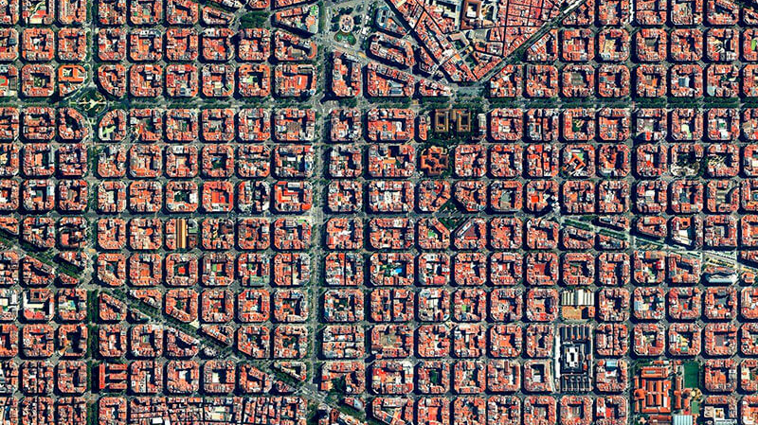
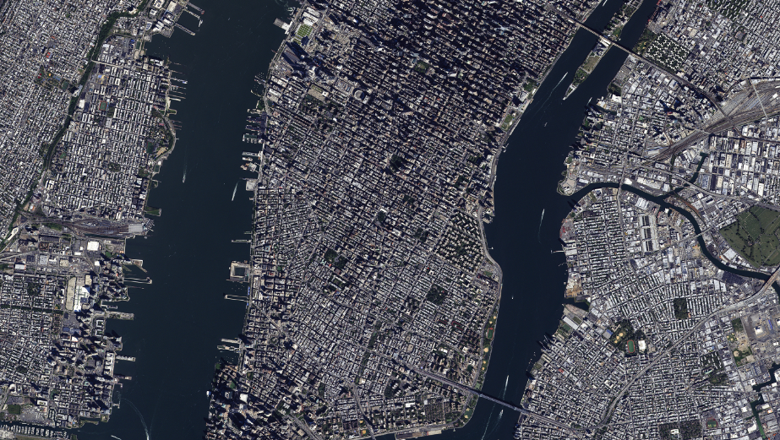
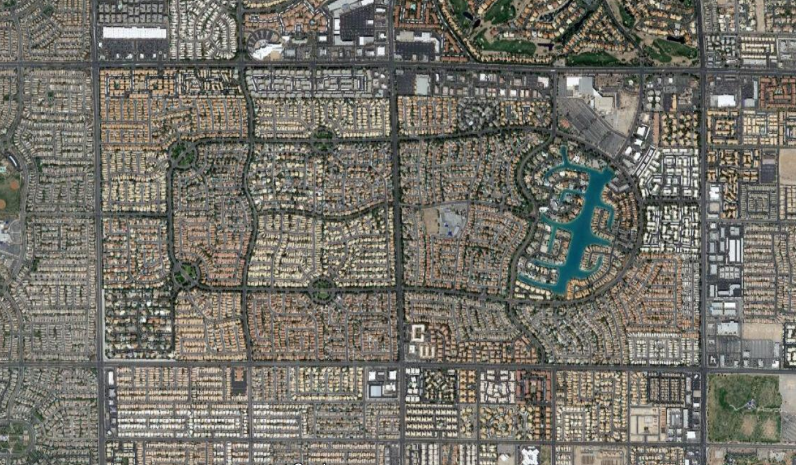
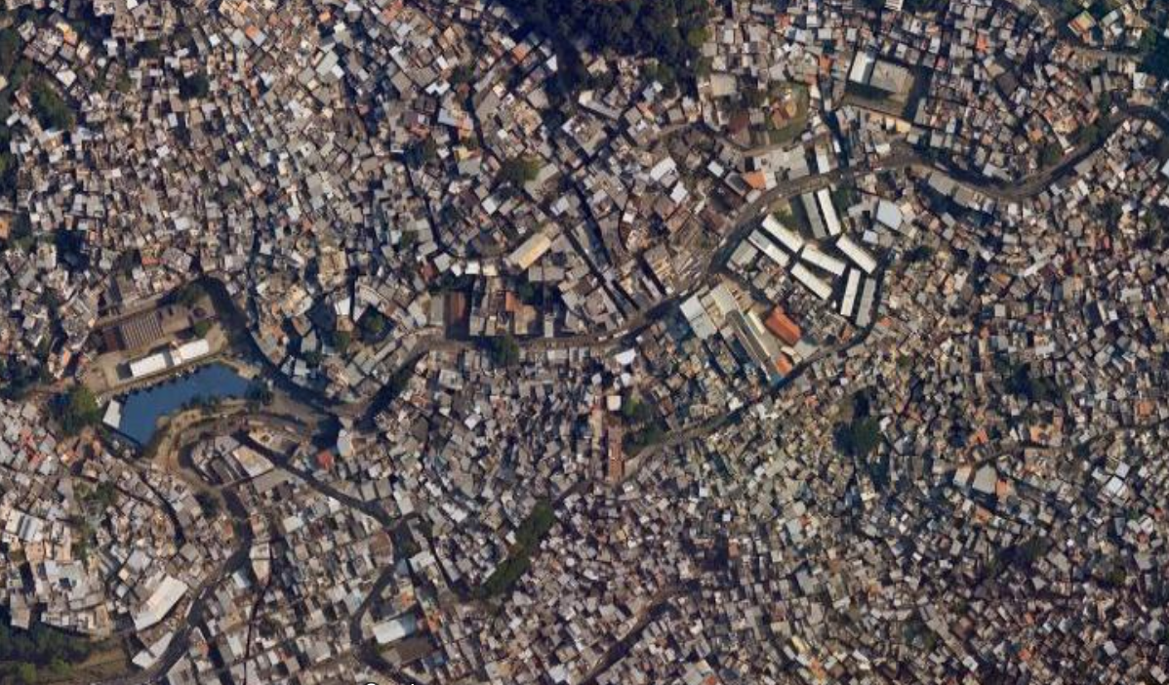

Slide 7
Research question

Slide 8
Research question
What does an accessible city look like to different people?

Slide 9
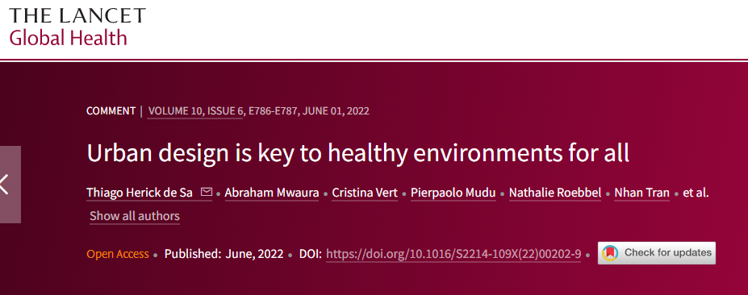

Slide 10
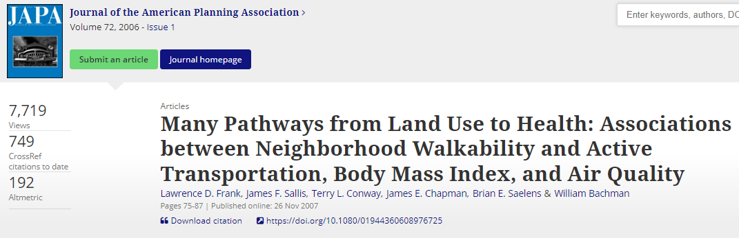

Slide 11
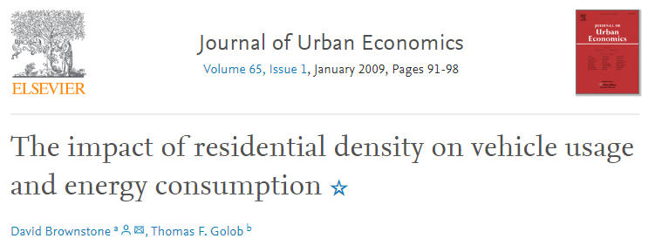

Slide 12
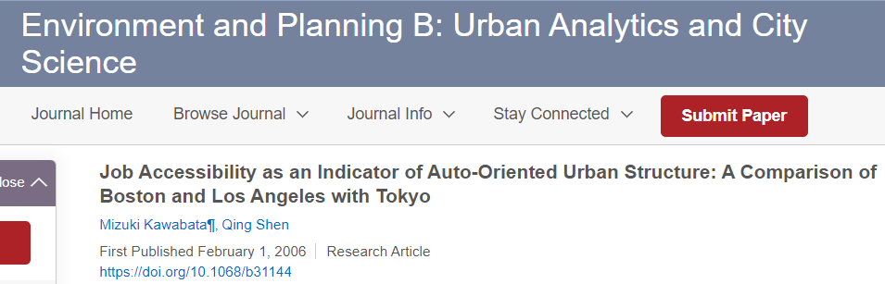

Slide 13
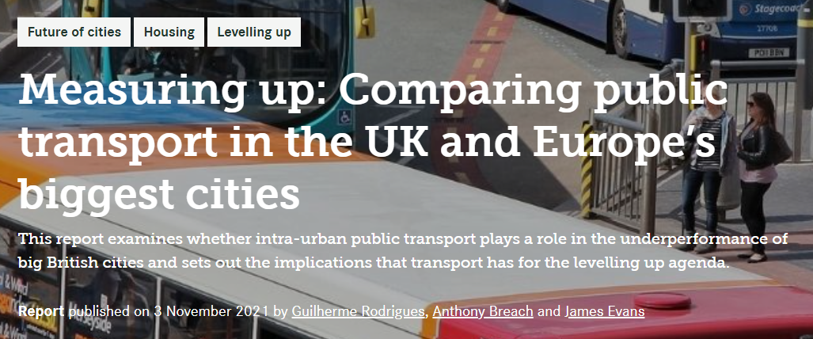

Slide 14
Research question
Multi-city comparisons
Detailed urban form characterisation
Comprehensive routing algorithm
Demographic profiling
Innovative destination selection method

Slide 15
Research question
Identify best practices and explore their potential implementation in different contexts
Multi-city comparisons
Detailed urban form characterisation
Comprehensive routing algorithm
Demographic profiling
Innovative destination selection method

Slide 16
Methods

Slide 17
Accessibility score
Morphometric analysis
Socioeconomic analysis

Slide 18
Accessibility score
Morphometric analysis
Socioeconomic analysis

Slide 19
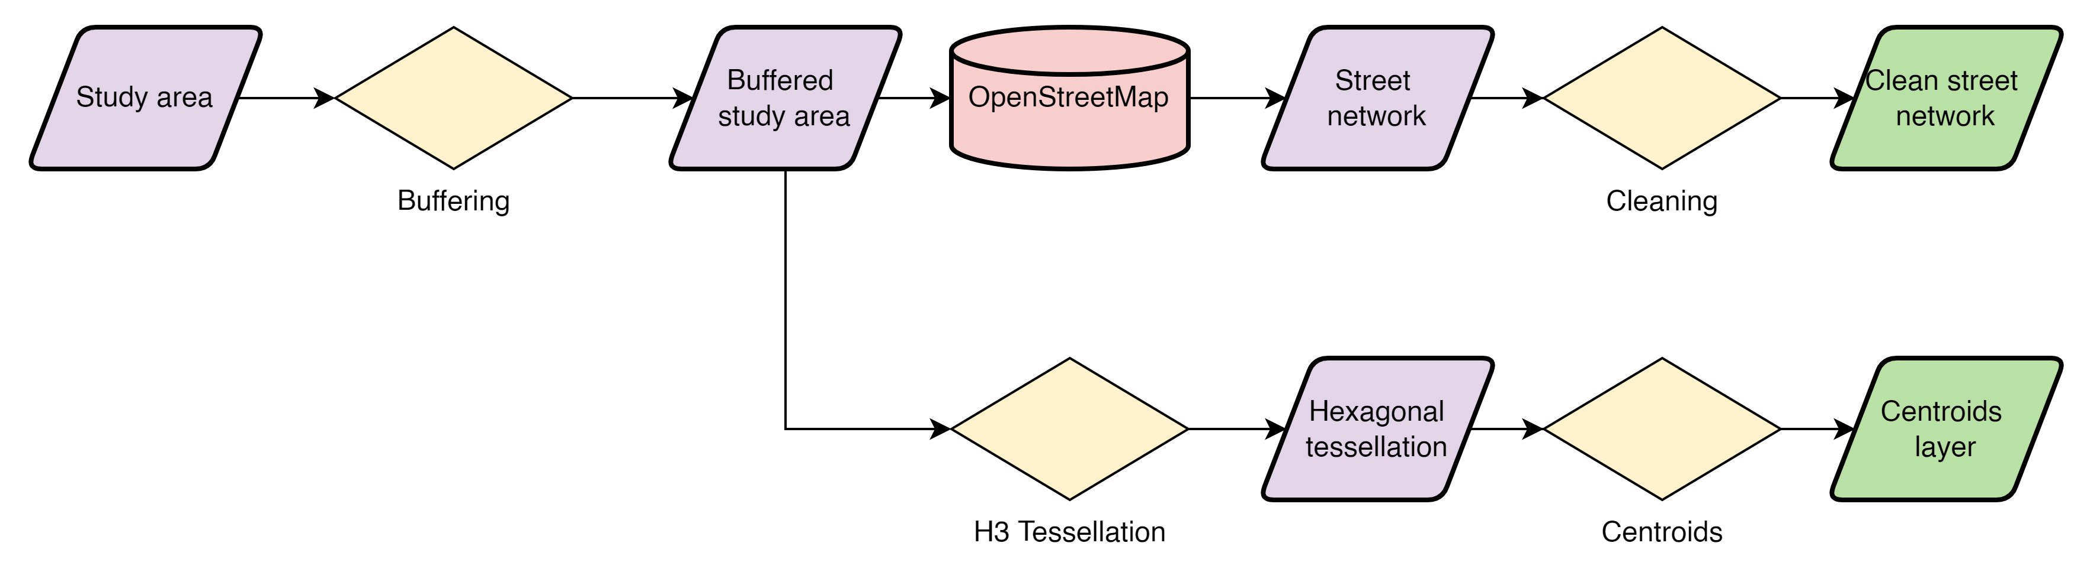
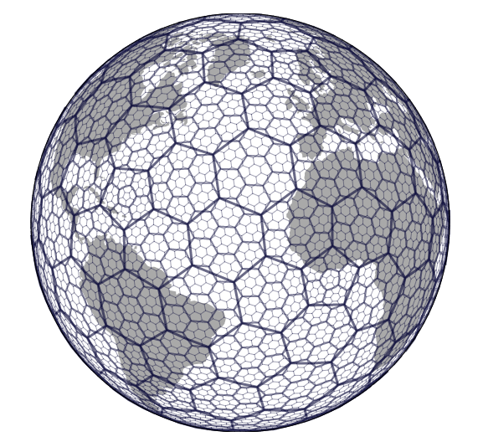
Methods – Accessibility score

Slide 20

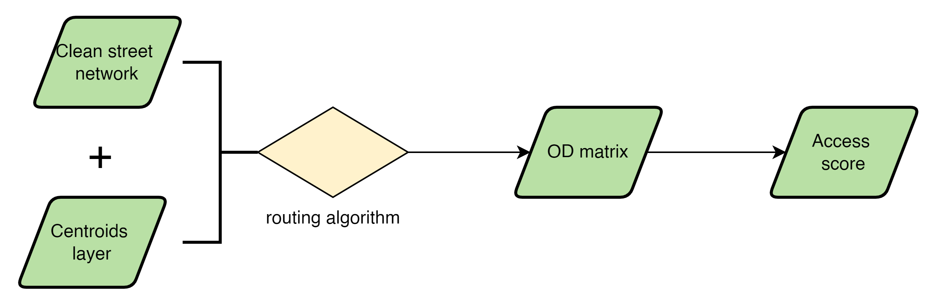
Methods – Accessibility score

Slide 21

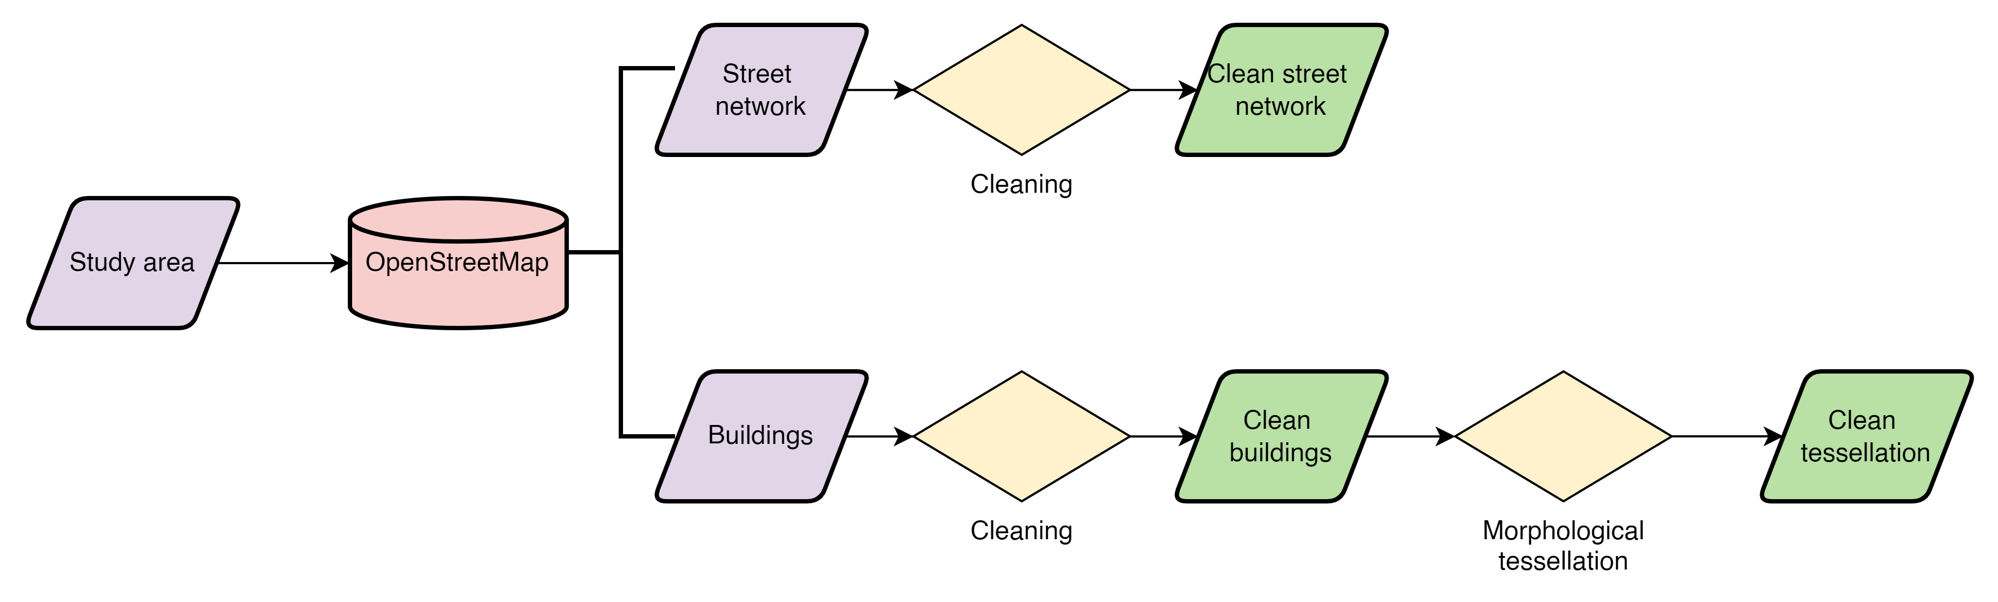
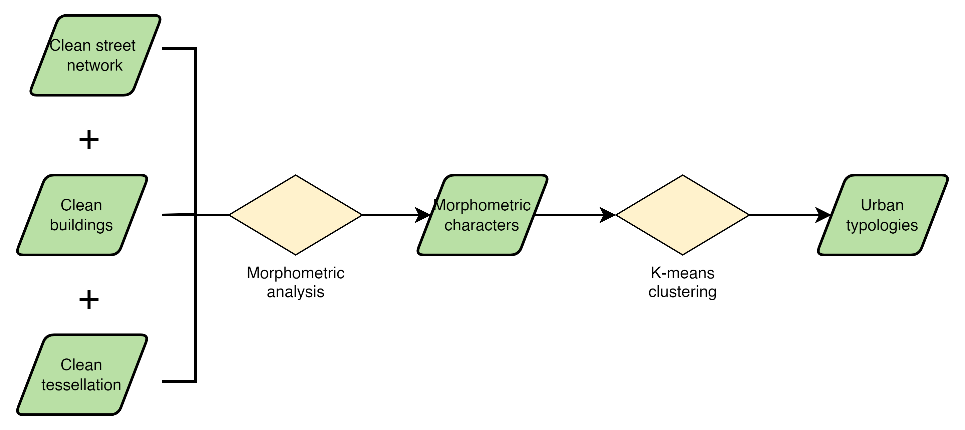
Methods – Morphometric analysis

Slide 22
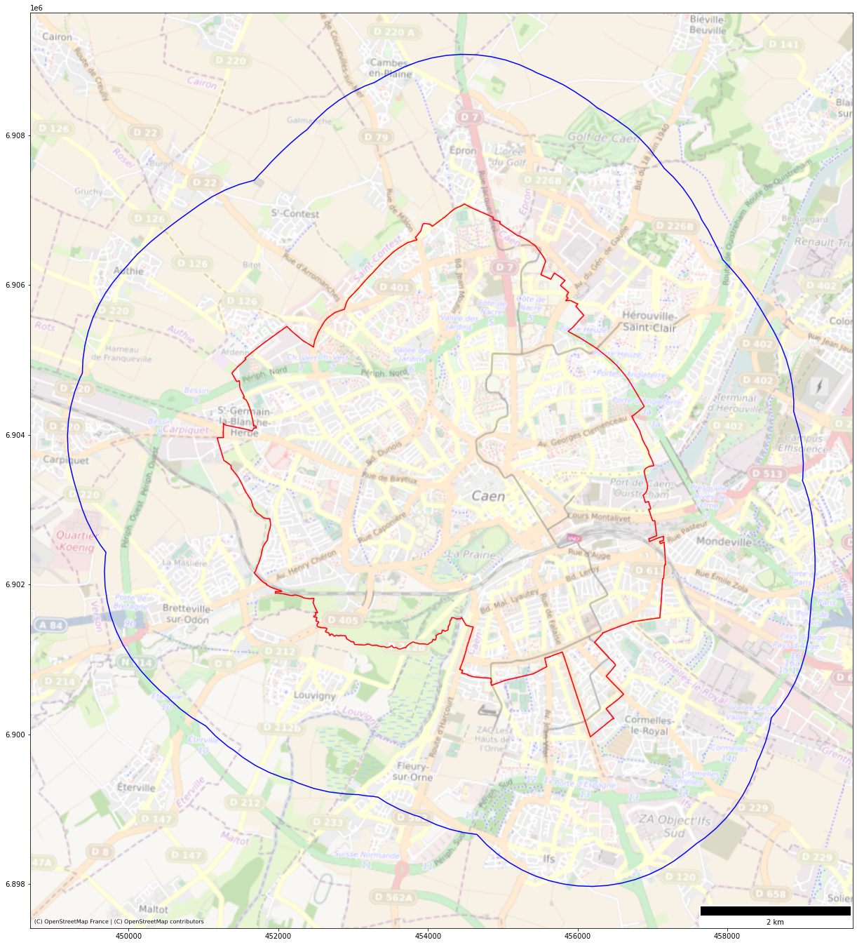

Slide 23
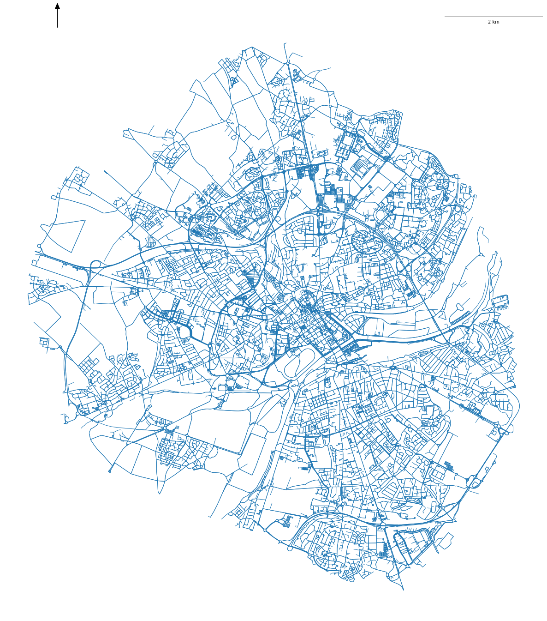

Slide 24
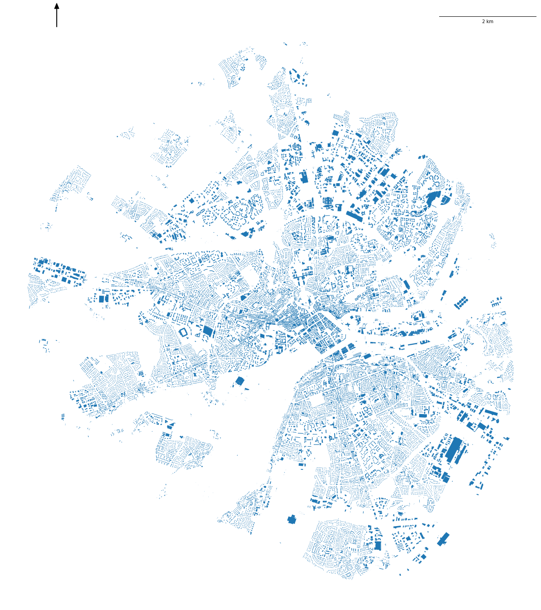

Slide 25


Slide 26
Results

Slide 27
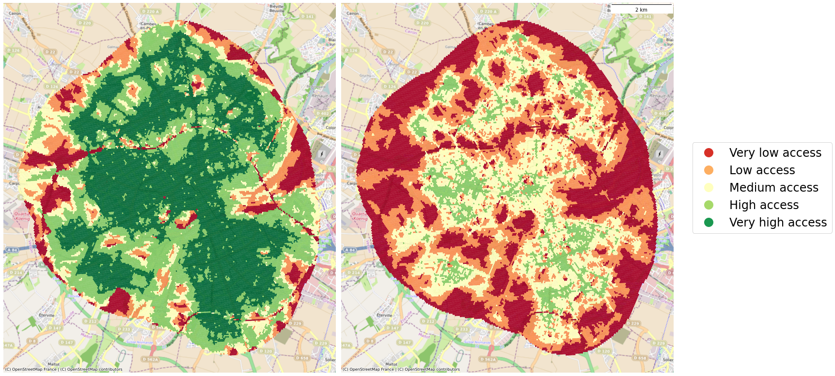
Access score adults
Access score seniors

Slide 28
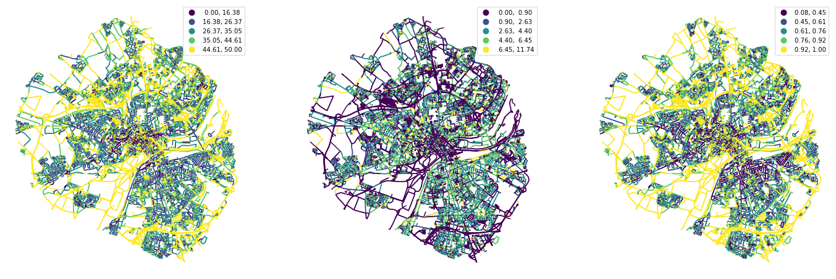
Width
Width deviation
Openness

Slide 29
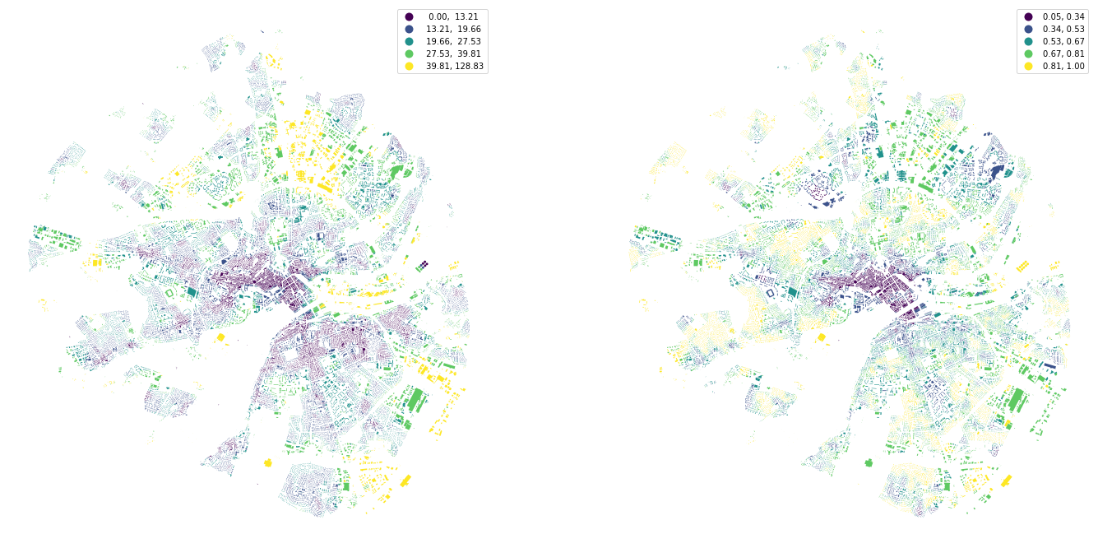
Inter-building distance
Adjacency

Slide 30
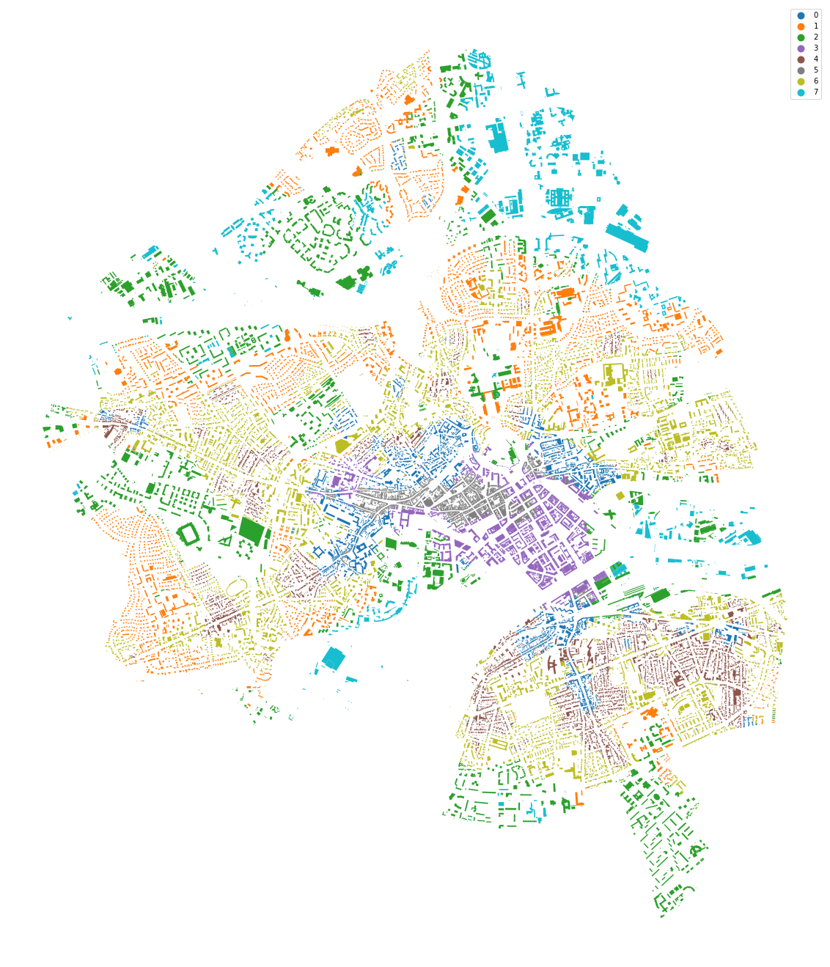
Urban typologies

Slide 31
Conclusions & future work

Slide 32
Conclusions & future work
After a very preliminary exploration, results suggest there is a relationship between accessibility and certain morphometric characters
Hexagonal tessellation can be a useful tool to standardise analyses across multiple study areas.

Slide 33
Conclusions & future work
GWR to quantify relationships between accessibility and urban form
Incorporate amenities as destinations
Assign weights to amenities based on demographic profiles
Socioeconomic & land use variables - Dasymetric population
Deep learning for urban tissue simulation

Slide 34

Thank you

